Slide 1
Acute and Perioperative Care of Burn-injured Patient
R2 Kittiphit Ulit
Adviser L.t.Col. Supansa Ngamvitroj

Slide 2
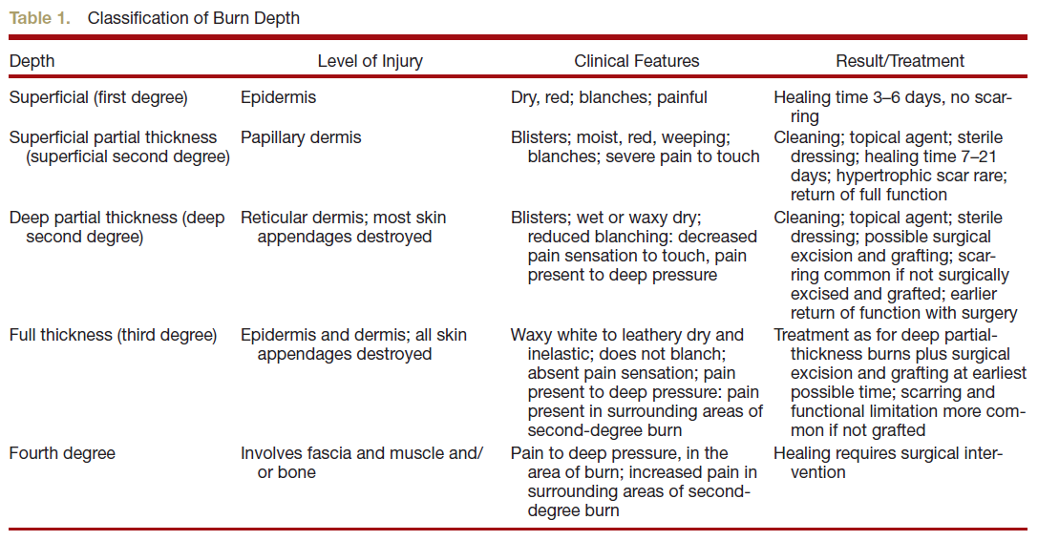

Slide 3
Burn injury pathophysiology
Massive tissue destruction
Activation of a cytokine-mediated inflammatory response
Effects at sites local and distant from the burn
Loss of intravascular fluid into burned areas and edema formation (in nonburned sites)
Burn shock

Slide 4
Burn injury pathophysiology
Early phase/ burn shock
Depletion of intravascular volume
Increased systemic vascular resistance (due to release of catecholamines, antidiuretic hormone, and hemoconcentration)
Depressed cardiac output
Hypermetabolic/hyperdynamic phase
Develops over 48 to 72 h after injury
Increased oxygen consumption, carbon dioxide production, and protein wasting
Supranormal cardiac output, tachycardia, and decreased systemic vascular resistance

Slide 5
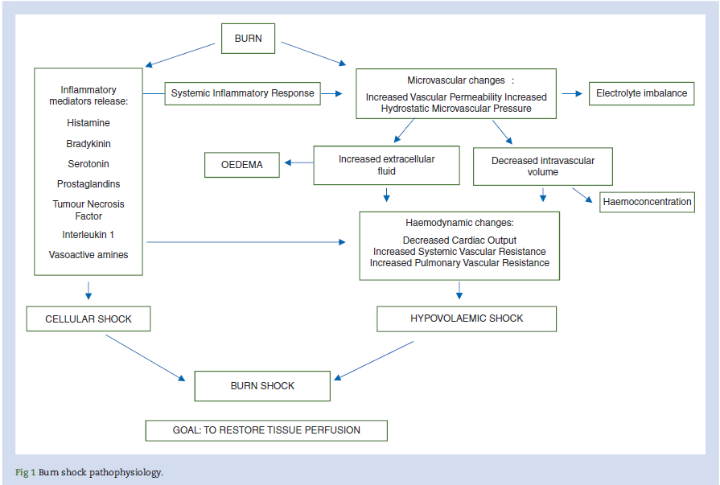

Slide 6
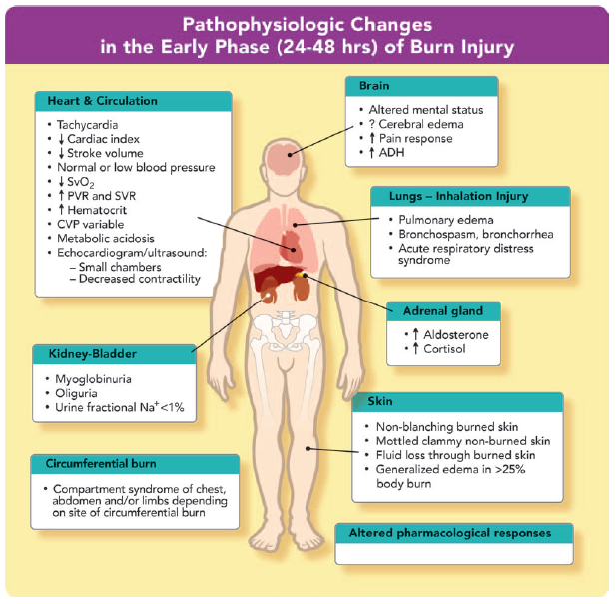

Slide 7
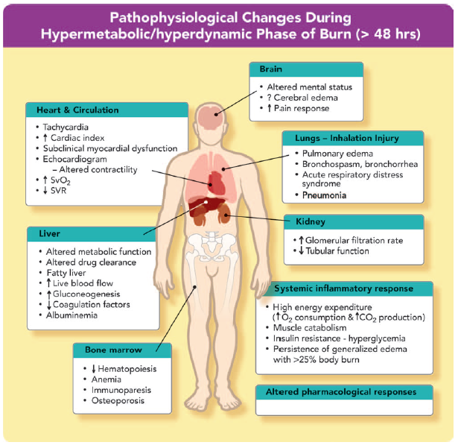

Slide 8
Inhalation injury
Increase the morbidity and mortality
Increase resuscitation fluid requirements up to 50%
Chest radiographs are usually normal
Mechanisms
Direct injury from hot gases
Chemical injury due to toxic products
Impairment of oxygen transport/utilization by carbon monoxide and cyanide

Slide 9
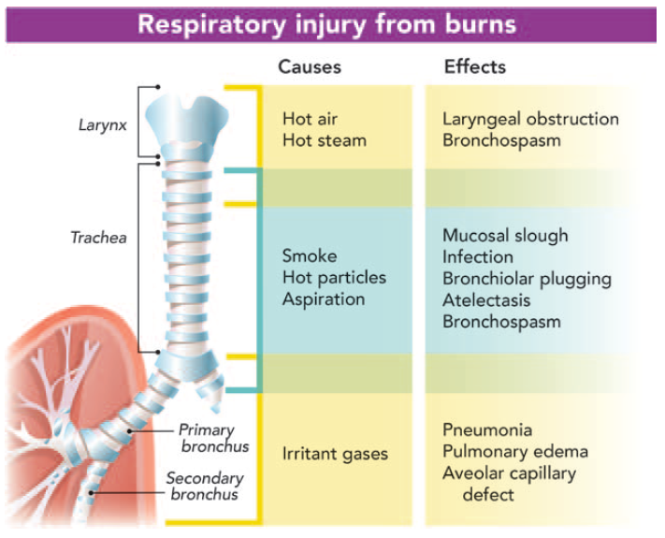

Slide 10
Inhalation injury
Upper airway edema
Resolves in 3 to 6 days
Elevation of the head of the bed
Avoidance of excessive fluid administration
Injury to the airways and lung in the absence of inhalational injury
Inflammatory mediators
Fluid resuscitation
infection

Slide 11
Inhalation injury
Carbon monoxide
Oxyhemoglobin dissociation curve shifts to the left
Carboxyhemoglobin levels >15% are toxic; >50% are lethal
half-life 4 h with room air, 40 to 60 min with 100% oxygen

Slide 12
Inhalation injury
Cyanide
Metabolic acidosis (lactic acid production)
Concentrations >20 ppm : dangerous.
Concentrations > 100 ppm can lead to seizures, coma, respiratory failure, and death
The other treatment of inhalation injury
Airway management
Lung-protective mechanical ventilation
Aggressive pulmonary toilet
Notes:
Mortality persists at a rate of approximately 4%. risk factors as predictive of death after burns: age older
than 60 yr, burn size greater than 40% body surface area,
and inhalation injury
The mortality was 0.3, 3, 33,
or 90%, depending on whether 0, 1, 2, or 3 risk factors
were present

Slide 13
Initial evaluation and management
Begins at the scene of injury
Airway assessment is the first priority
Safer to intubate the patient early
Diagnosis of inhalation injury
Notes:
exposure to fire and smoke (especially in combination
with impaired avoidance behavior such as loss of
consciousness or entrapment in an enclosed space)
physical examination (burns over face, singed
nasal or facial hair, carbonaceous sputum, hypoxia, hoarse
voice, and bronchorrhea, and/or bronchospasm)

Slide 14
Fluid resuscitation
Rapid and effective intravascular volume replenishment
Stop burn shock
<15% TBSA
Oral or intravenous fluid administered
At 1.5 times maintenance rate

Slide 15
Fluid resuscitation
The Parkland formula
The most common guide used
Recommends isotonic crystalloid initially
The use of colloids 24 h after injury
General trend now
initiate colloid infusions earlier than the previously recommended time of 24 h

Slide 17
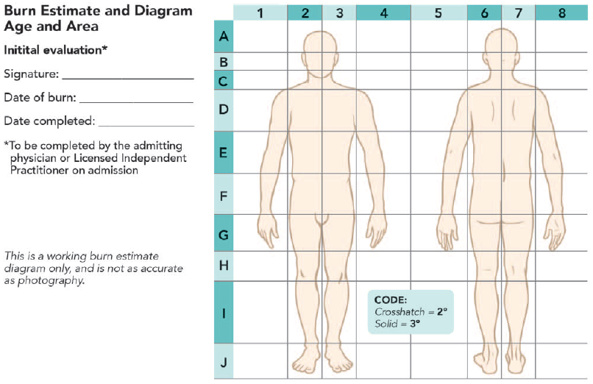
Lund–Browder burn diagram and table

Slide 18
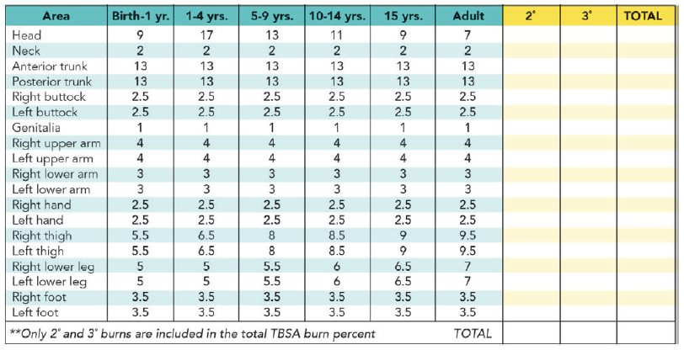

Slide 19
Fluid resuscitation
Lactated Ringer’s solution
Titrated to physiologic endpoints
After 36 to 48 h
Capillary integrity returns to normal in nonburned areas
Reabsorption of edema fluid occurs over the next 1 to 2 weeks
Notes:
Side effects of large-volume crystalloid resuscitation include
exacerbation of generalized edema, pleural and pericardial
effusions, and intestinal ileus with abdominal or limb compartment
Syndrome

Slide 20
Fluid resuscitation

Slide 21
Fluid resuscitation update
Fluid resuscitation in first 24h
Should be higher from estimated by Parkland formula
Major burn resuscitation
Should ideally be performed according to goal-directed therapy
With transpulmonary thermodilution methods
Improvement in the cardiac index, ScvO2 , oxygen delivery, and MODS
Taking the ITBV and EVLW as end points

Slide 22
Fluid resuscitation update
The initial resuscitation fluid should be a balanced crystalloid.
Ringer’s acetate
Protect the electrolytic balance in large replacements,
The crystalloid of choice

Slide 23
Fluid resuscitation update
Colloids seem inappropriate during the first hours
Gelatins have not shown superiority over crystalloids
Hypertonic solutions, albumin, and plasma
lower volume requirement
lower intra-abdominal pressure
lower incidence of compartment syndrome

Slide 24
Anesthetic management

Slide 25
Preoperative Evaluation
The time and extent of burn injury
Airway evaluation
Presence of inhalation injury
Current resuscitation regimen and patient’s response
Potential vascular access sites
Tolerance to enteral feeding and/or gastric residues

Slide 26
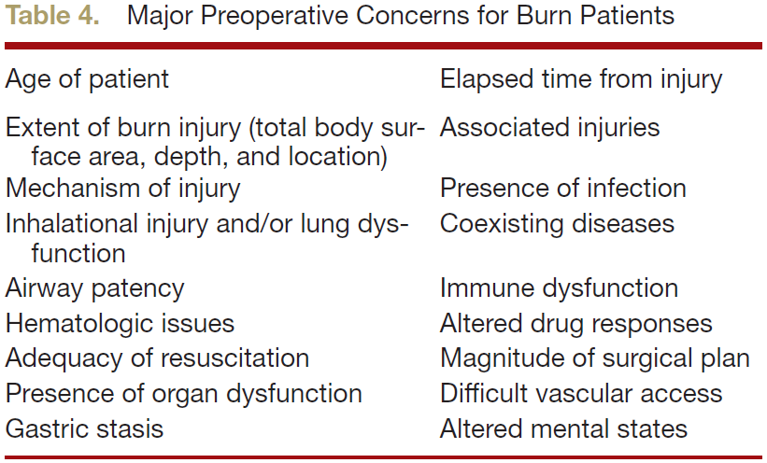
Preoperative evaluation

Slide 27
Intraoperative Evaluation

Slide 28
Airway management
Airway assessment
Preexisting abnormalities
Current injury
Sign of glottic obstruction
Assessment of mandibular mobility
Mouth opening
Facial wound
Dressing and nasogastric tube

Slide 29
Airway management
Fiberoptic intubation with maintaining spontaneous ventilation
In children: ketamine-induced sedation
Gastric emptying
Infection/sepsis
Intestinal edema
Opioid
Securing the ETT
Cuffed tube in pediatric population
Tracheostomy

Slide 30
Vascular access
Place vascular catheter through burn wound
Subclavian vein, internal jugular vein, femoral vein, intraosseous cannulation
Ultrasound guidance localization

Slide 31
Ventilatory management
Avoid ventilation-induced morbidity
Setting
TV 6 ml/kg Ideal BW
Plateau pressure < 30 cmH₂O
Higher ventilation rates
Hypermetabolic stage
Increase CO2 production
Postoperative mechanical ventilation

Slide 32
Ventilatory management
Extubation
Assessment pulmonary status
Assessment upper airway and glottis
Good air leak after deflation of ET cuff
Visualization of laryngeal structure

Slide 33
Monitoring
Surgical staples: for EKG
Sites for placement of pulse oximetry
Finger, toe, ear, nose, or tongue
If a blood pressure cuff placed over grafted wounds
Protect the underlying area
The cuff should be sterile

Slide 34
Monitoring
Arterial line
Hypovolumia
BUN/Cr ratio >20 or FeNa <1%
Temperature monitoring
Neuromuscular blocking monitoring
Multiport central venous catheter

Slide 35
Intrahospital patient transport
Patients requiring mechanical ventilation during transport require at least
Two anesthesia personnel
An anesthesia personnel and respiratory therapist or nurse
To manage ventilation, observe the monitors, and administer medications during transport
Adequate sedation and analgesia and possibly muscle relaxation

Slide 36
Phamacologic considerations
Decrease the concentration of albumin
Plasma protein loss through skin
Dilution by resuscitation fluids
Increase in volume of distribution of almost every drug
Pharmacodynamic changes at target organs alter drug–receptor interactions (e.g., succinylcholine)

Slide 37
Phamacologic considerations
Acute injury phase (0 to 48 h)
Decrease cardiac output
Decrease renal and hepatic blood flow : decrease drug elimination
Hyperdynamic phase
Increased cardiac output and blood flow to the kidneys and liver
Increased clearances (e.g., propofol, fentanyl)

Slide 38
Phamacologic considerations
Hepatic enzyme activity
Phase I reactions, which include oxidation, reduction, hydroxylation, and demethylation, are impaired (e.g., diazepam).
Phase II reactions involve conjugation, glucuronidation, and sulfation and seem to be relatively unaffected (e.g.,lorazepam)

Slide 39
Phamacologic considerations
Decrease concentration of albumin
binds to mostly acidic and neutral drugs
Increases concentration of AAG twofold or greater
α1-acid glycoprotein (AAG) binds cationic drugs, such as lidocaine, propranolol, muscle relaxants, and some opioids

Slide 40
Muscle relaxants
Avoid succinylcholine administration in patients 48 h after burn injury
Exaggerated hyperkalemic, induce cardiac arrest
Increase extrajunctional acetylcholine receptors

Slide 41
Muscle relaxants
Decreased sensitivity to the neuromuscular effects of nondepolarizing muscle relaxants (NDMRs)
3 to 7 days after burn injury
up-regulation of fetal and α7 (neuronal type) acetylcholine receptors at the muscle membrane
increased binding to AAG and enhanced renal and hepatic elimination of the NDMRs
Increased rocuronium dose of 1.2 to 1.5 mg/kg for rapid sequence induction has been recommended, the onset approximates 90 seconds

Slide 42
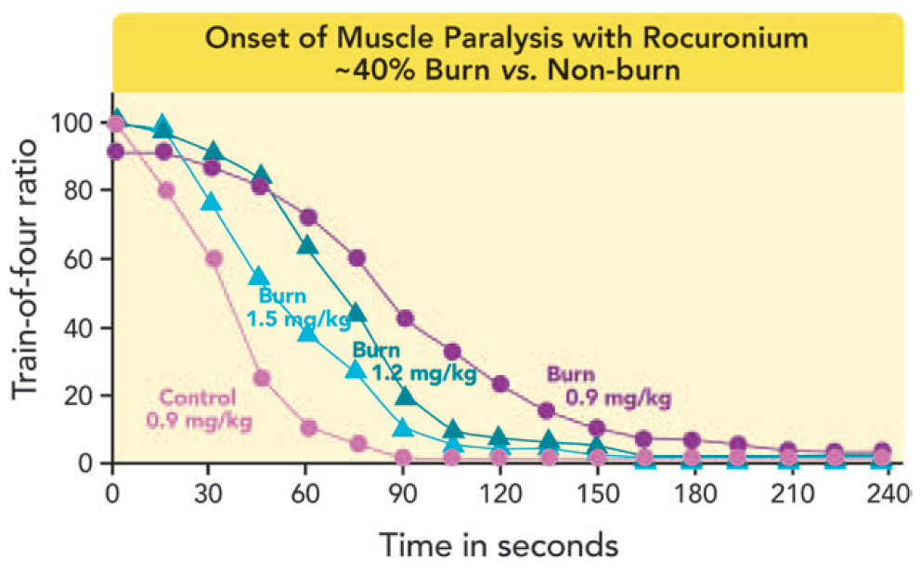
Muscle relaxants

Slide 43
Anesthetic drugs
Volatile anesthetics
Choice of volatile anesthetic does not appear to influence outcome
IV anesthetics
Clearance and volume of distribution are increased during the hyperdynamic phase,
Decreased hypnotic effect

Slide 44
Opioids
Opioid requirements are increased
Opioid tolerance
Infusions of sedatives and narcotics should be continued and not stopped in OR
maintained to reach a steady state of effect

Slide 45
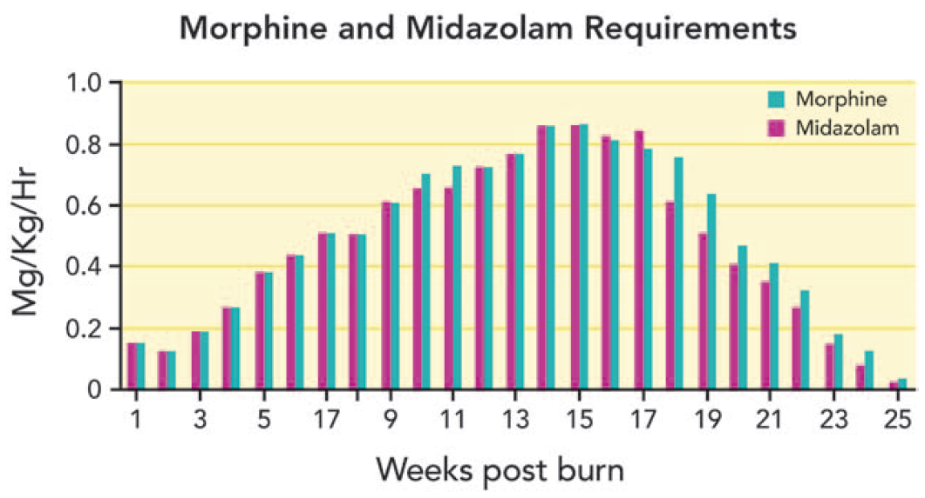

Slide 46
Opioids
Changes in the spinal cord receptors
Down-regulation of μ-opioid receptors
Up-regulation of protein kinase C-γ and N-methyl-d-aspartate receptors
Clonidine, dexmedetomidine, ketamine, and methadone
Effective in the treatment of pain for who develop extreme tolerance to morphine

Slide 47
Ketamine
Benefit
Hemodynamic stability
preserving airway patency
decreasing airway resistance
Agent of choice if one wishes to avoid manipulation of the airway
Treat burn- and opioid-induced tolerance to narcotics
Notes:
e.g., after placement of fresh facial grafts, for splint or dressing removal, for brief procedures such as dressing or line changes, insertion of Foley catheters in pediatric patients, or for patients with toxic epidermal necrolysis syndrome

Slide 48
Regional anesthesia
Potential benefit
Intraoperative anesthesia
Postoperative analgesia
Facilitating rehabilitation
Split-thickness skin donor site pain
LA injected into donor site before havesting
Subcutaneous catheter infusion
Truncal block (paravertebral and TAP block)
Peripheral nerve block (femoral nerve block)
Central neuraxial blocks

Slide 49
Metabolic and nutritional management
Continuous enteral or parenteral nutrition
Difficult to meet the high caloric requirements
Multiple surgical procedures
Periods of 8-hour fasting before surgery make it
Enteral feeding during surgery beyond the pylorus has been successful
Provided the airway was secured via a cuffed ETT or tracheostomy

Slide 50
Blood loss during burn wound excision
Difficult to estimate blood loss during excision
Attention to several physiological variables is necessary
Estimates of blood loss during burn excision
2.6 to 3.4% of the blood volume for every 1% TBSA excised

Slide 51
Blood loss during burn wound excision
Multiple techniques to minimize intraoperative bleeding
Application of topical thrombin
Staged procedures
Brisk operative pace
Topical application or subcutaneous injection of vasoconstrictors

Slide 52
Intraoperative fluid administration and blood transfusion
Parenteral nutrition infusion not be stopped
Avoid hypoglycemia
Restricting fluids and administering diuretics
Elimination edema
Use of colloids
Continued blood loss may
Indicate transfusion
To prevent anemia

Slide 53
Intraoperative fluid administration and blood transfusion
Use of fresh-frozen plasma
to prevent coagulopathy
In massive hemorrhage

Slide 54
Temperature management
Increase in the hypothalamic core temperature set point
Increase the metabolic rate
Decreased body temperature during burn excisions
increase blood loss
worsen morbidity and mortality

Slide 55
Temperature management
Maintain body temperature in the operating room
warming blankets
radiant warmers
blood/ fluid warmers
minimizing skin surface exposure
wrapping the head and extremities
Maintained at 80 to 100 F (27 to 38 C)

Slide 56
Postoperative care
Extubate in the operating room
Assesment of airway patency
Metabolic status
Ongoing bleeding
Return again for surgery

Slide 57
Postoperative care
Safe transport to the ICU and transfer of care to the ICU staff
Continued bleeding concealed by dressing,
Hypothermia
Emergence delirium
Analgesic requirement
Monitoring

Slide 58
Pain management
Pain of burns has
Hyperalgesic and allodynic components
background pain, and procedure-related pain
Exacerbated by anxiety
Posttraumatic stress disorder up to 30%
Patient-controlled analgesia
Sensitivity to analgesics varies
From increased sensitivity to tolerance

Slide 59
Pain management
Treatment of opioid tolerance includes
Switching of opioids (morphine →fentanyl → methadone)
Coadministration of drugs acting on nonopioid receptors (ketamine, NSAIDS, α2-agonist, gabapentin)
Acetaminophen and nonsteroidal antiinflammatory drugs (NSAIDs)
First-line analgesic for minor burns
NSAIDs and benzodiazepines are combined with opioids
to relieve procedural pain

Slide 60
Pain management
Dexmedetomidine
Used to provide sedation–analgesia
To decrease opioid requirements

Slide 61
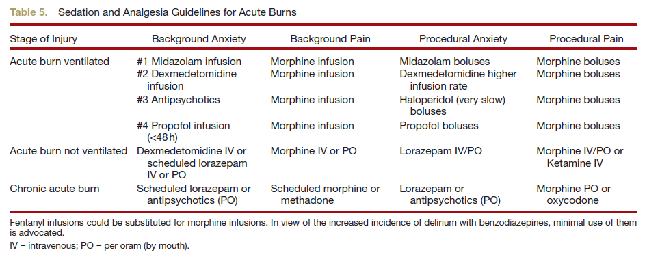
Pain management

Slide 62
Thank you

